Slide 1
Order the Faces by Manifold Learning
CSIC 5011 Final Project
Zhenghui CHEN
Department of Chemical and Biological Engineering, HKUST

Slide 2
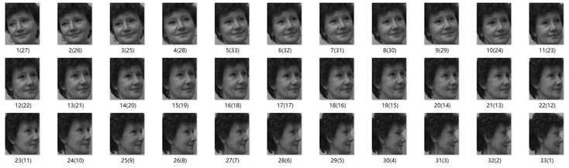
Introduction
Dataset
Goal
Sort the face orientation of 33 images from left to right by manifold learning methods.
Compare the performance of different methods (Diffusion map, MDS, ISOMAP, LLE, LSTA, TSNE).
Explore the effect of nearest neighbor number and find the best parameter value.

Slide 3
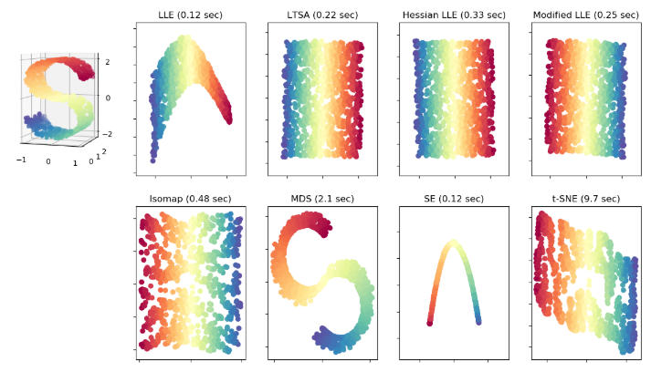
Methodology
Manifold learning
Diffusion map
Multidimensional scaling (MDS)
ISOMAP
Locally linear Embedding (LLE)
Local Tangent Space Alignment (LTSA)
T-distributed Stochastic Neighbor Embedding (TSNE)
Find the low-dimensional manifold in the high-dimensional space and the corresponding embedded mapping.
Recover the low-dimensional manifold structure from the high-dimensional sampled data
Achieve dimensional reduction and data visualization

Slide 4
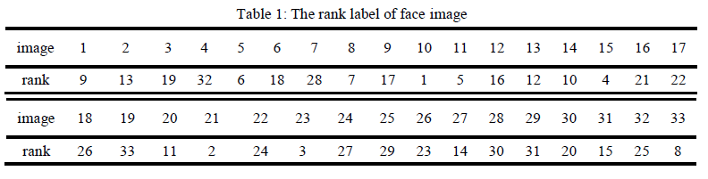
Methodology
1. Ground truth
Left face direction: small rank number Right face direction: large rank number
2. Predict the face order
Use different manifold learning methods to order the face on first eigenvector and visualize on 2D embedding graph.
3. Evaluation metric
Absolute error (AE) : the difference of rank position between prediction and ground truth label for the same image.

Slide 5
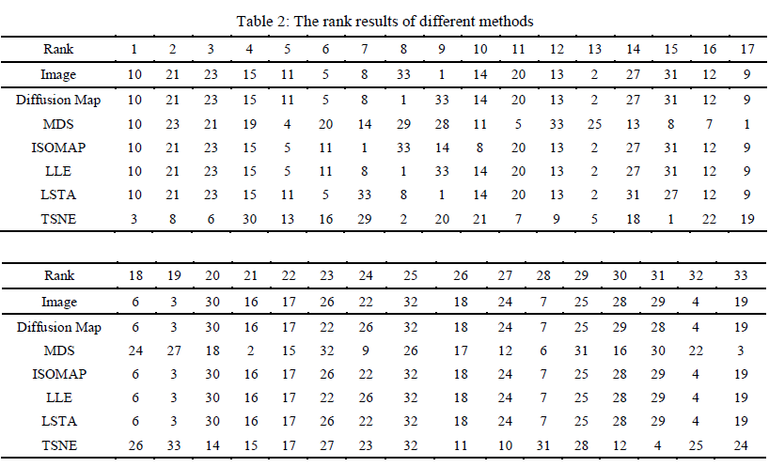

Results
Rank results

Slide 6
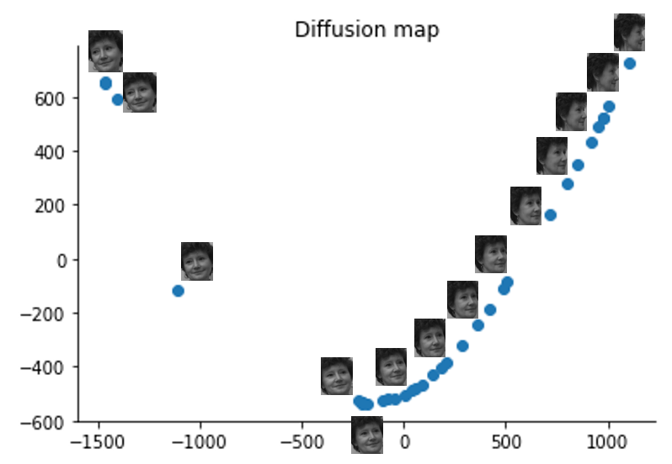
Results
Visualization (Diffusion map)
2D Embedding graph

Slide 7
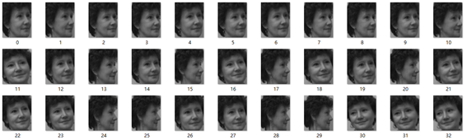
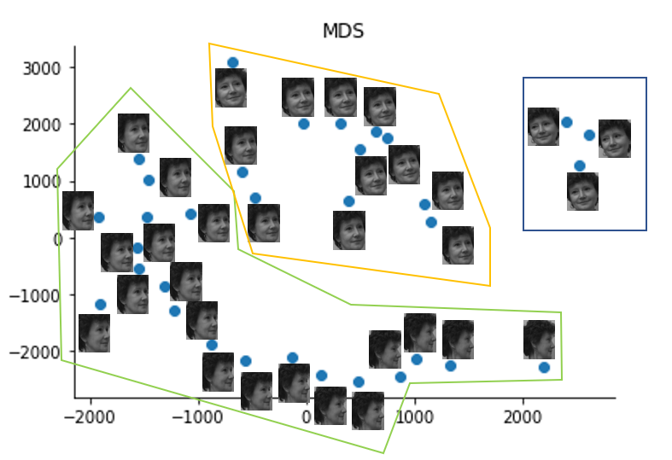
Results
Order the faces by first eigenvector
Visualization (MDS)
2D Embedding graph

Slide 8
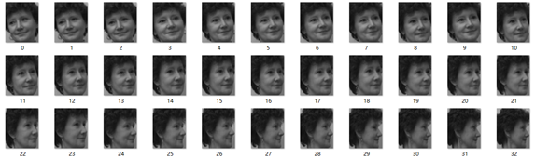
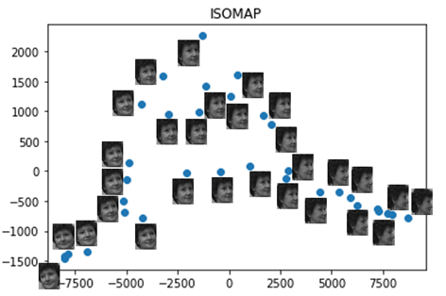
Results
Order the faces by first eigenvector
ISOMAP
5 nearest neighbor
2D Embedding graph

Slide 9
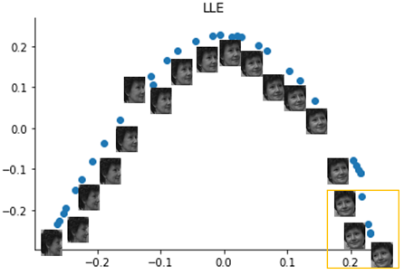
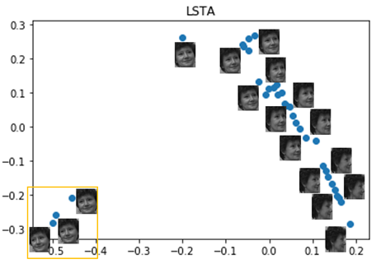
Results
5 nearest neighbor
5 nearest neighbor

Slide 10
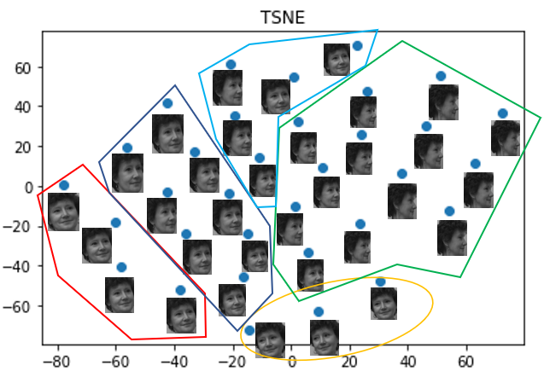
Results
Visualization (TSNE)
2D Embedding graph

Slide 11
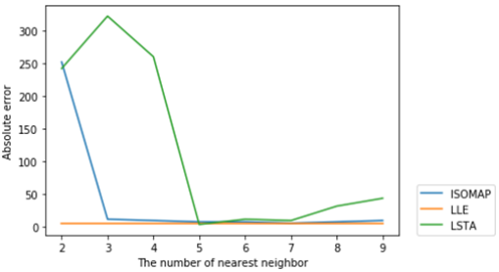
Results
Parameter study
LLE is more stable and robust with different number of nearest neighbor.
LSTA achieves smallest absolute error of 4 with 5 nearest neighbor.
ISOMAP achieves smallest absolute error of 6 with 7 nearest neighbor

Slide 12
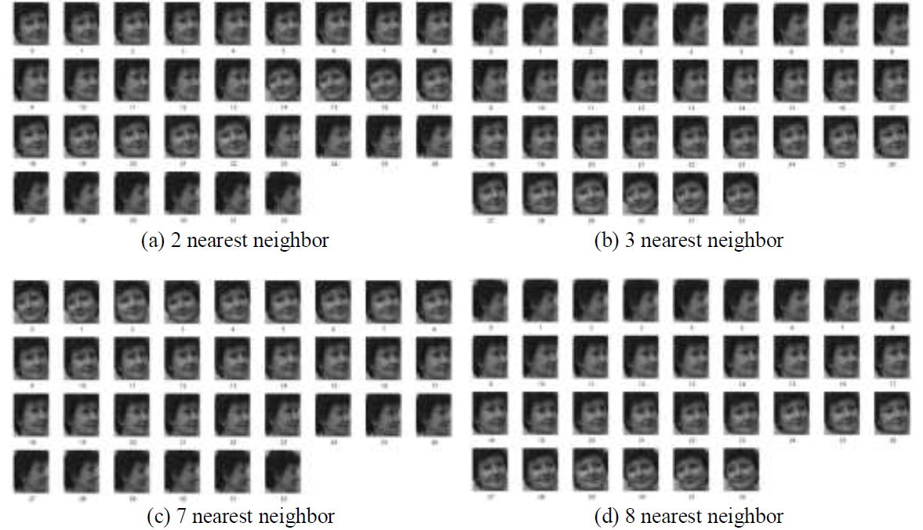
Results
Parameter study

Slide 13
Conclusion
1. MDS and TSNE perform poorly by the order of first eigenvector while the remaining methods have a good performance.
2. The 2D scatter plots of Diffusion map, ISOMAP, LLE, LSTA are very intuitive.
3. We find the best nearest neighbor number for ISOMAP, LLE, LSTA.

